Slide 1
Data Mining: Concepts and Techniques (3rd ed.) — Chapter 9 — Classification: Advanced Methods
Jiawei Han, Micheline Kamber, and Jian Pei
University of Illinois at Urbana-Champaign &
Simon Fraser University
©2011 Han, Kamber & Pei. All rights reserved.
1
Notes:
1

Slide 2
Chapter 9. Classification: Advanced Methods
Bayesian Belief Networks
Classification by Backpropagation
Support Vector Machines(SVM)
2
Notes:
2

Slide 3
Bayesian Belief Networks
Bayesian belief networks (also known as Bayesian networks, probabilistic networks): allow class conditional independencies between subsets of variables
A (directed acyclic) graphical model of causal relationships
Represents dependency among the variables
Gives a specification of joint probability distribution
Nodes: random variables
Links: dependency
X and Y are the parents/ancestor of Z, and Y is the parent of P. P is non-descendent of Z.
No dependency between Z and P (b/c nondesc.)
Has no loops/cycles
X
Y
Z
P
3
Notes:
3

Slide 4
Bayesian Belief Network: An Example
Family
History (FH)
Smoker (S)
CPT: Conditional Probability Table for variable LungCancer:
(FH, S)
(FH, ~S)
(~FH, S)
(~FH, ~S)
LC
0.8
0.5
0.7
0.1
Lung Cancer
(LC)
Emphysema
~LC
0.2
0.5
0.3
0.9
shows the conditional probability for each possible combination of its parents
Positive XRay
Dyspnea
Derivation of the probability of a particular combination of values of X, from CPT:
Bayesian Belief Network

Slide 5
Training Bayesian Networks: Several Scenarios
“How does a Bayesian belief network learn?”
In the learning or training of a belief network, a number of scenarios are possible.
The network topology (or “layout” of nodes and arcs) may be constructed by human experts or inferred from the data.
The network variables may be observable or hidden in all or some of the training tuples.
The hidden data case is also referred to as missing values or incomplete data.

Slide 6
Training Bayesian Networks: Several Scenarios
Scenario 1: Given both the network structure/topology and all variables observable: compute only the CPT entries
Scenario 2: Network structure known, some variables hidden: gradient descent (greedy hill-climbing) method, i.e., search for a solution along the steepest descent of a criterion function
Weights are initialized to random probability values
At each iteration, it moves towards what appears to be the best solution at the moment, without backtracking
Weights are updated at each iteration & converge to local optimum
Scenario 3: Network structure unknown, all variables observable: search through the model space to reconstruct network topology
Scenario 4: Unknown structure, all hidden variables: No good algorithms known for this purpose
D. Heckerman. A Tutorial on Learning with Bayesian Networks. In Learning in Graphical Models, M. Jordan, ed.. MIT Press, 1999.

Slide 7
Chapter 9. Classification: Advanced Methods
Bayesian Belief Networks
Classification by Backpropagation
Support Vector Machines (SVM)
7
Notes:
7

Slide 8
Classification by Backpropagation
Backpropagation: A neural network learning algorithm
Started by psychologists and neurobiologists to develop and test computational analogues of neurons
A neural network: A set of connected input/output units where each connection has a weight associated with it
During the learning phase, the network learns by adjusting the weights so as to be able to predict the correct class label of the input tuples
Also referred to as connectionist learning due to the connections between units

Slide 9
Neural Network as a Classifier
Weakness
Long training time
Require a number of parameters typically best determined empirically, e.g., the network topology or “structure.”
Poor interpretability: Difficult to interpret the symbolic meaning behind the learned weights and of “hidden units” in the network
Strength
High tolerance to noisy data
Ability to classify untrained patterns
Well-suited for continuous-valued inputs and outputs
Successful on an array of real-world data, e.g., hand-written letters
Algorithms are inherently parallel
Techniques have recently been developed for the extraction of rules from trained neural networks

Slide 10
Neural Network as a Classifier…
There are many different kinds of neural networks and neural network algorithms.
The most popular neural network algorithm is backpropagation, which gained repute in the 1980s.

Slide 11
A Multi-Layer Feed-Forward Neural Network
Output vector
Output layer
Two layered neural network (one hidden layer and other one is output layer) input layer is not counted b/c it just passes the values.
Hidden layer
w_{ij}
Input layer
Input vector: X
Notes:
MK: Note – different notation than used in book. Will have to standardize notation.

Slide 12
How A Multi-Layer Neural Network Works
The inputs to the network correspond to the attributes measured for each training tuple
Inputs are fed simultaneously into the units making up the input layer
They are then weighted and fed simultaneously to a hidden layer (a “neuronlike” units)
The outputs of the hidden layer units can be input to another hidden layer, and so on. The number of hidden layers is arbitrary, although usually only one
The weighted outputs of the last hidden layer are input to units making up the output layer, which emits the network's prediction
The network is feed-forward: None of the weights cycles back to an input unit or to a previous layer’s output unit.
From a statistical point of view, networks perform nonlinear regression: Given enough hidden units and enough training samples, they can closely approximate any function

Slide 13
Defining a Network Topology
Decide the network topology:
Specify # of units in the input layer,
# of hidden layers (if > 1),
# of units in each hidden layer, and
# of units in the output layer
Normalize the input values for each attribute measured in the training tuples to [0.0—1.0], it speeds up the learning process.
One input unit per domain value, each initialized to 0. (see notes)
Neural network can predict a class label(classification) or a continuous value (Regression)
Output, if for classification and more than two classes, one output unit per class is used
Once a network has been trained and its accuracy is unacceptable, repeat the training process with a different network topology or a different set of initial weights.
Notes:
An attribute continuous A has values (a₀,a₁,a₂) then if A=a₀ then input will be (1,0,0), if A=a₁ then input will be (0,1,0) and so on…

Slide 14
Backpropagation
Iteratively process a set of training tuples & compare the network's prediction with the actual known target value.
For each training tuple, the weights are modified to minimize the mean squared error between the network's prediction and the actual target value
Modifications are made in the “backwards” direction: from the output layer, through each hidden layer down to the first hidden layer, hence “backpropagation”
Steps
Initialize weights to small random numbers, associated with biases
Propagate the inputs forward (by applying activation function)
Backpropagate the error (by updating weights and biases)
Terminating condition (when error is very small, etc.)

Slide 15
Neuron: A Hidden/Output Layer Unit
bias
μ_{k}
x₀
w₀
x₁
w₁
∑
f
output y
x_{n}
w_{n}
Input
vector x
weight
vector w
weighted
sum
Activation
function
An n-dimensional input vector x is mapped into variable y by means of the scalar product and a nonlinear function mapping
The inputs to unit are outputs from the previous layer. They are multiplied by their corresponding weights to form a weighted sum, which is added to the bias associated with unit. Then a nonlinear activation function is applied to it.
15
Notes:
15

Slide 16
Chapter 9. Classification: Advanced Methods
Bayesian Belief Networks
Classification by Backpropagation
Support Vector Machines(SVM)
16
Notes:
16

Slide 17
SVM—Support Vector Machines
A relatively new classification method for both linear and nonlinear data
It uses a nonlinear mapping to transform the original training data into a higher dimension
With the new dimension, it searches for the linear optimal separating hyperplane (i.e., “decision boundary”)
With an appropriate nonlinear mapping to a sufficiently high dimension, data from two classes can always be separated by a hyperplane
SVM finds this hyperplane using support vectors (“essential” training tuples) and margins (defined by the support vectors)

Slide 18
SVM—History and Applications
Vapnik and colleagues (1992)—groundwork from Vapnik & Chervonenkis’ statistical learning theory in 1960s
Features: training can be slow but accuracy is high owing to their ability to model complex nonlinear decision boundaries (margin maximization)
Used for: classification and numeric prediction
Applications:
handwritten digit recognition, object recognition, speaker identification, benchmarking time-series prediction tests

Slide 19
For linear data
To explain the mystery of SVMs, let’s first look at the simplest case—
a two-class problem where the classes are linearly separable.
Let the data set D be given as
(X1, y1),(X2, y2), … , (XjDj, yjDj),
where Xi is the set of training tuples with associated class labels, yi.
Each yi can take one of two values, either +1 or -1 (i.e., yi ∈{+1, - 1),
corresponding to the classes buys_computer =yes and buys_computer =no, respectively

Slide 20
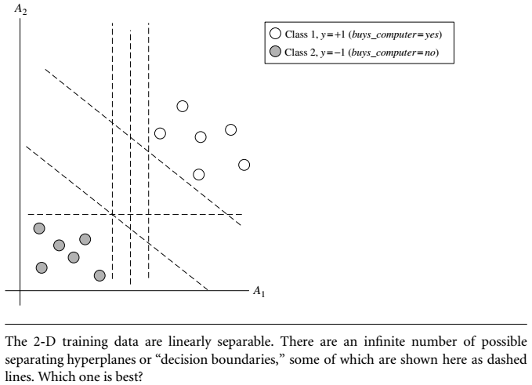

Slide 21
There are an infinite number of separating lines that could be drawn.
We want to find the “best” one, that is, one that (we hope) will have the minimum classification error on previously unseen tuples.
Note that if our data were 3-D (i.e., with three attributes), we would want to find the best separating plane.
For n dimension we need best fit hyperplan
We will use hyperplan to refer to the decision boundary that we are seeking, regardless of the number of input attributes.

Slide 22
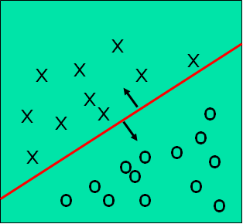
Classification: A Mathematical Mapping
Classification: predicts categorical class labels
E.g., Personal homepage classification
x_{i} = (x₁, x₂, x₃, …), y_{i} = +1 or –1
x₁ : # of word “homepage”
x₂ : # of word “welcome”
Mathematically, x ∈ X = ℜ^{n}, y ∈ Y = {+1, –1},
We want to derive a function f: X → Y
Linear Classification
Binary Classification problem
Data above the red line belongs to class ‘x’
Data below red line belongs to class ‘o’
Examples: SVM, Perceptron, Probabilistic Classifiers
22
Notes:
22

Slide 23
Discriminative Classifiers
Advantages
Prediction accuracy is generally high
As compared to Bayesian methods – in general
Robust, works when training examples contain errors
Fast evaluation of the learned target function
Bayesian networks are normally slow
Criticism
Long training time
Difficult to understand the learned function (weights)
Bayesian networks can be used easily for pattern discovery
Not easy to incorporate domain knowledge
Easy in the form of priors on the data or distributions
23
Notes:
23

Slide 24
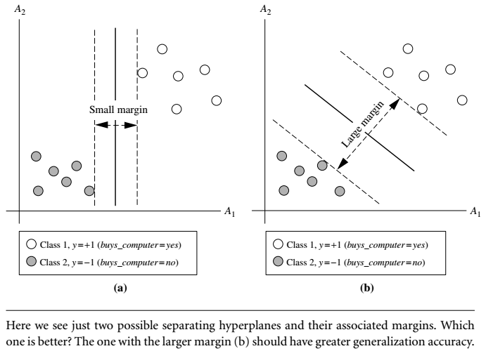
SVM—General Philosophy
How to find best line/hyperplane?
We solve it by finding maximum marginal hyperplane (MMH).

Slide 25
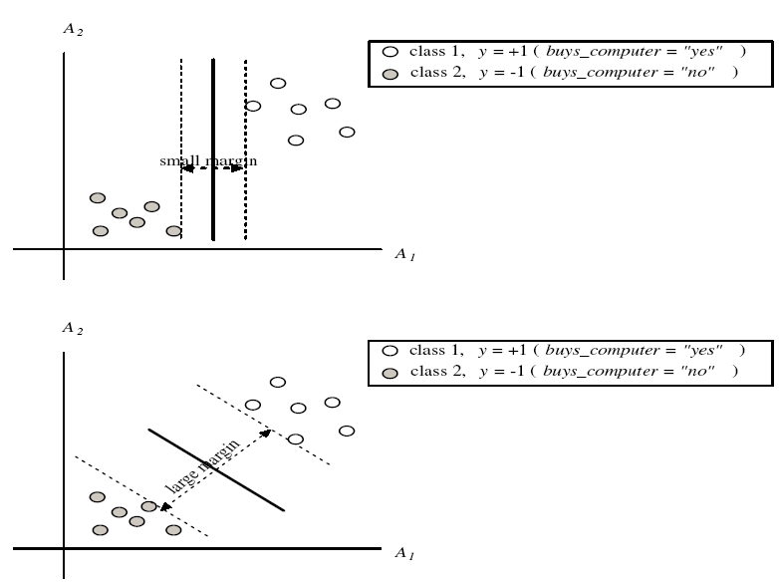
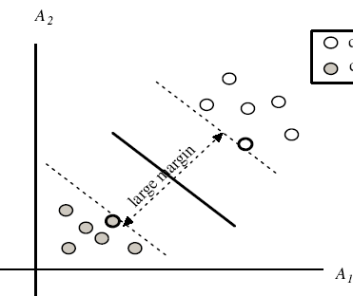
SVM—Margins and Support Vectors

Slide 26
SVM—When Data Is Linearly Separable
m
Let data D be (X₁, y₁), …, (X_{|D|}, y_{|D|}), where X_{i} is the set of training tuples associated with the class labels y_{i}
There are infinite lines (hyperplanes) separating the two classes but we want to find the best one (the one that minimizes classification error on unseen data)
SVM searches for the hyperplane with the largest margin, i.e., maximum marginal hyperplane (MMH)

Slide 27
SVM—Linearly Separable
A separating hyperplane can be written as
W ● X + b = 0
where W={w₁, w₂, …, w_{n}} is a weight vector and b a scalar (bias)
For 2-D it can be written as (e.g X=(x1,x2) i.e A1=x1, A2=x2
w₀ + w₁ x₁ + w₂ x₂ = 0
The hyperplane defining the sides of the margin:
H₁: w₀ + w₁ x₁ + w₂ x₂ ≥ 1 for y_{i} = +1, and
H₂: w₀ + w₁ x₁ + w₂ x₂ ≤ – 1 for y_{i} = –1
Any training tuples that fall on hyperplanes H₁ or H₂ (i.e., the sides defining the margin) are support vectors

Slide 28
SVM—General Philosophy
Small Margin
Large Margin
Support Vectors

Slide 29
Why Is SVM Effective on High Dimensional Data?
The complexity of trained classifier is characterized by the # of support vectors rather than the dimensionality of the data
The support vectors are the essential or critical training examples —they lie closest to the decision boundary (MMH)
If all other training examples are removed and the training is repeated, the same separating hyperplane would be found
The number of support vectors found can be used to compute an (upper) bound on the expected error rate of the SVM classifier, which is independent of the data dimensionality
Thus, an SVM with a small number of support vectors can have good generalization, even when the dimensionality of the data is high

Slide 30
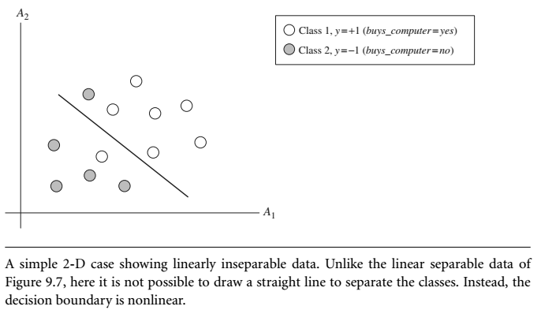
SVM—Linearly Inseparable

Slide 31
SVM—Linearly Inseparable
The good news is that the approach described for linear SVMs can be extended to create nonlinear SVMs for the classification of linearly inseparable data (also called nonlinearly separable data, or nonlinear data for short).
Such SVMs are capable of finding nonlinear decision boundaries (i.e., nonlinear hypersurfaces) in input space.
Two step process
First, we transform the original input data into a higher dimensional space using a nonlinear mapping.
Second step, searches for a linear separating hyperplane in the new space.

Slide 32
SVM vs. Neural Network
SVM
Deterministic algorithm
Nice generalization properties
Hard to learn – learned in batch mode using quadratic programming techniques
Using kernels can learn very complex functions
Neural Network
Nondeterministic algorithm
Generalizes well but doesn’t have strong mathematical foundation
Can easily be learned in incremental fashion
To learn complex functions—use multilayer perceptron (nontrivial)

